Slide 1
ST-Arm-v2-GUI-documentation
2023.01.20
서울과학기술대학교 기계설계로봇공학과
Gurban

Slide 2
개요
Setting up Unity
Create new project
Configure settings
Installing packages
Animated virtual hands
Spawning the robot

Slide 3
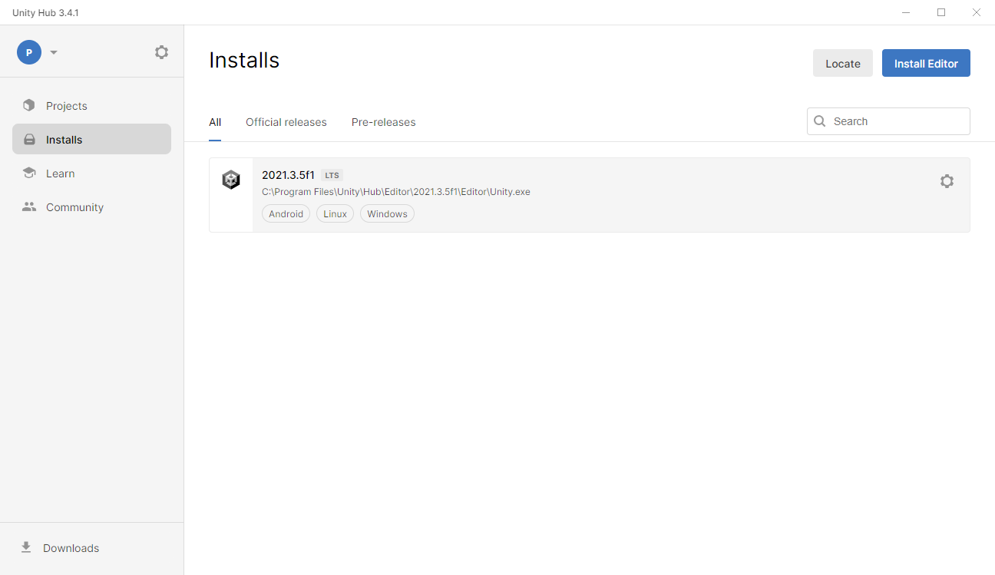
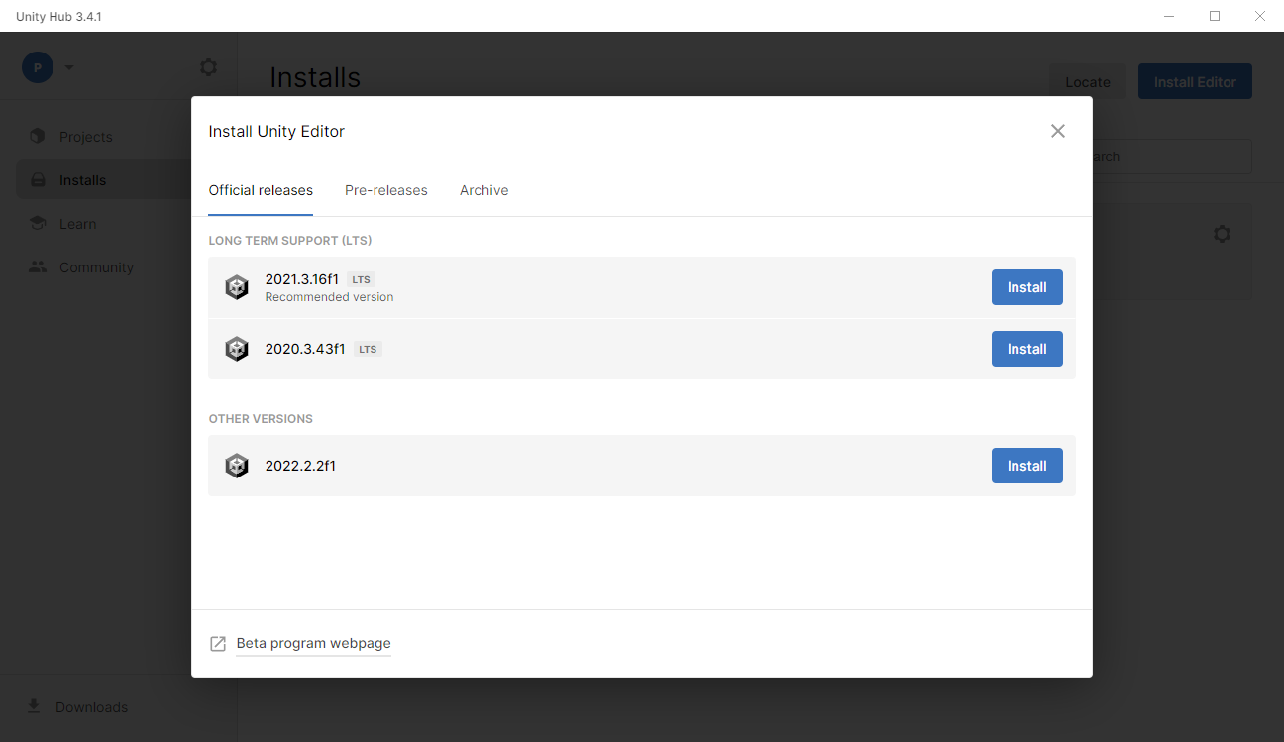
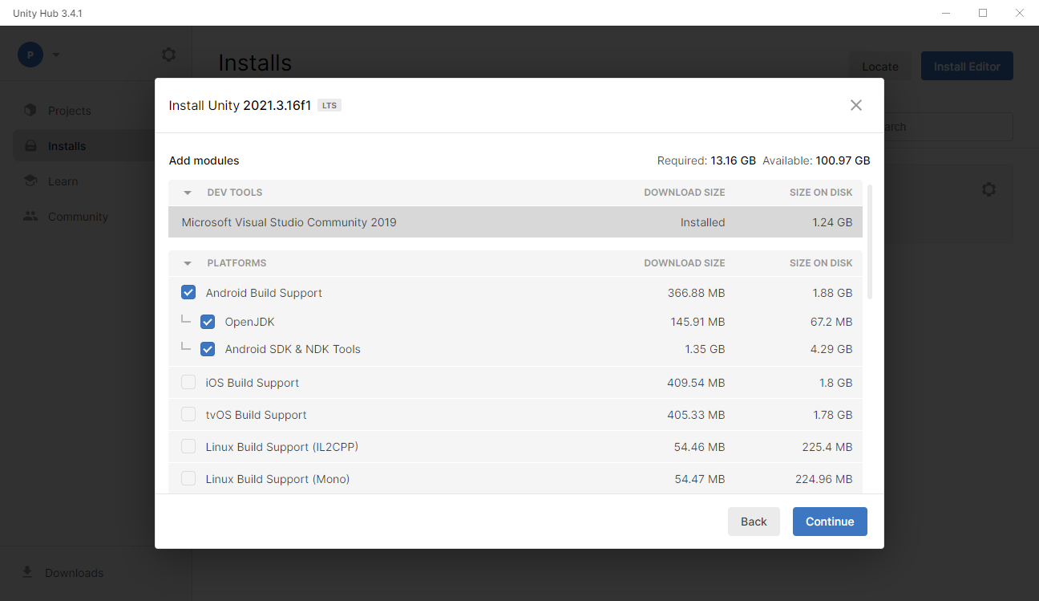
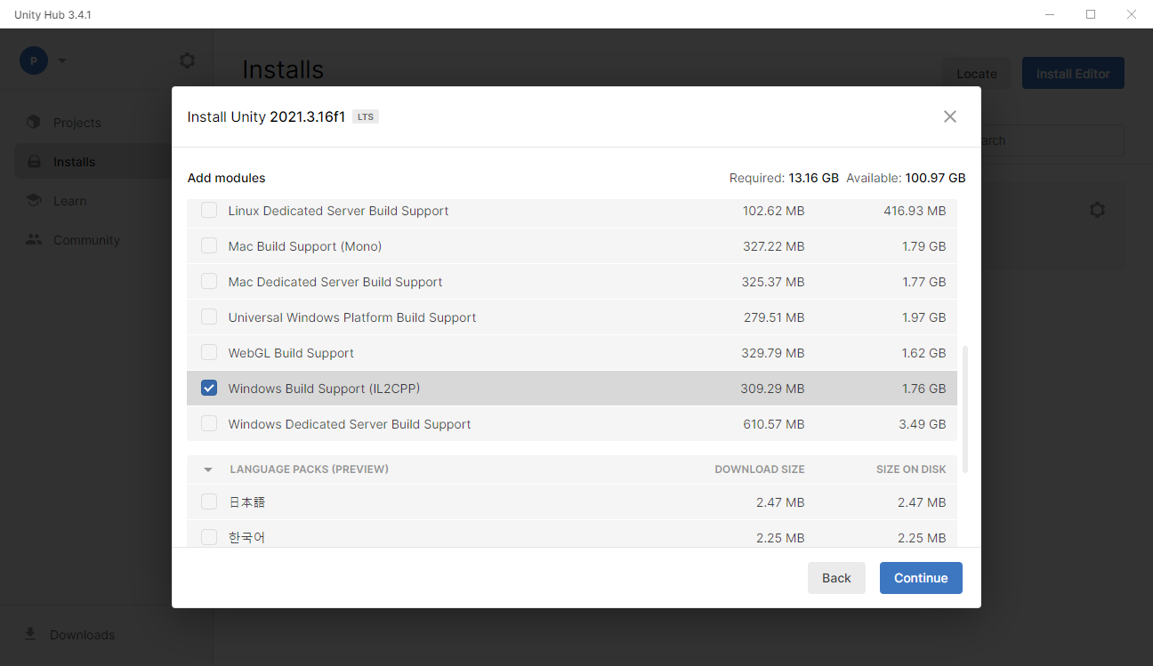
Setup Unity:
1
2
Open Unity Hub,
Go to the “Installs” menu
Press “Install Editor” button
Press “Install” button on the top right corner (recommended version)
Check “Android Build Support” (necessary for building on Oculus Quest 2 for standalone use)
Check “Windows Build Support(IIL2CPP)” (necessary for building on windows)
3
4
Notes:
Open Unity Hub,
Go to the “Intalls” menu
Press “Install Editor” button
Press “Install” button on the top right corner (recommended version)
Check “Android Build Support” (necessary for building on Oculus Quest 2 for standalone use)
Check “Windows Build Support(IIL2CPP)” (necessary for building on windows)

Slide 4
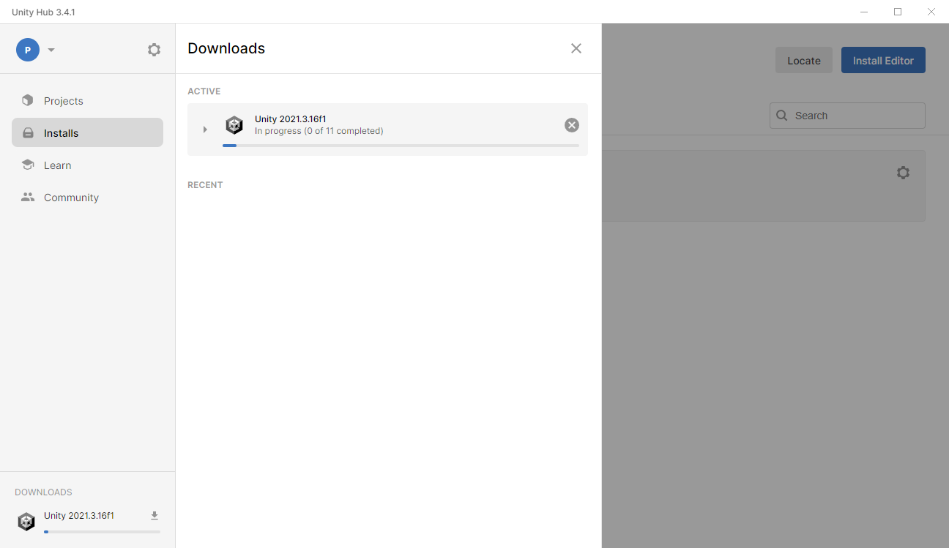
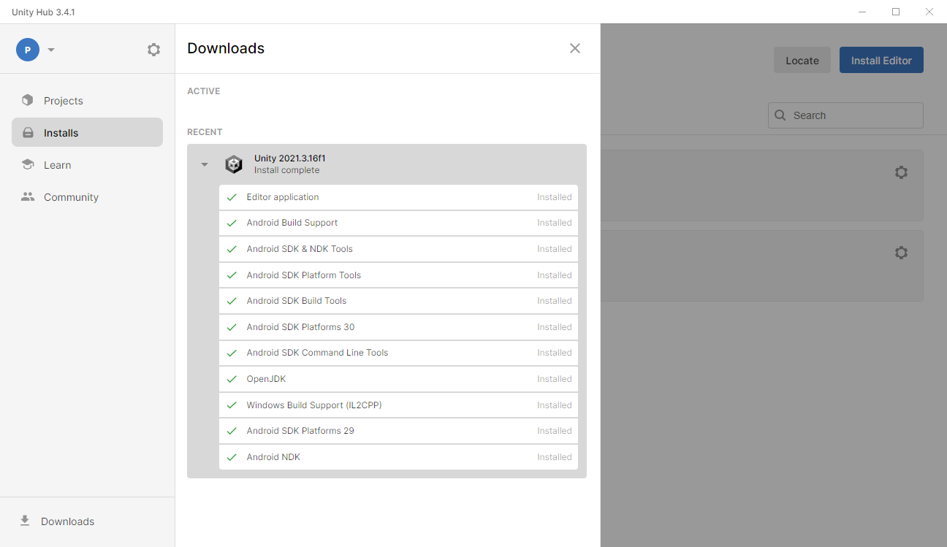
Setup Unity:
1
2
Wait (one eternity, lol) for installation complete.
Check if your listing of installs are same with this list.
Notes:
Wait (one eternity, lol) for installation complete.
Check if your listing of installs are same with this list.

Slide 5
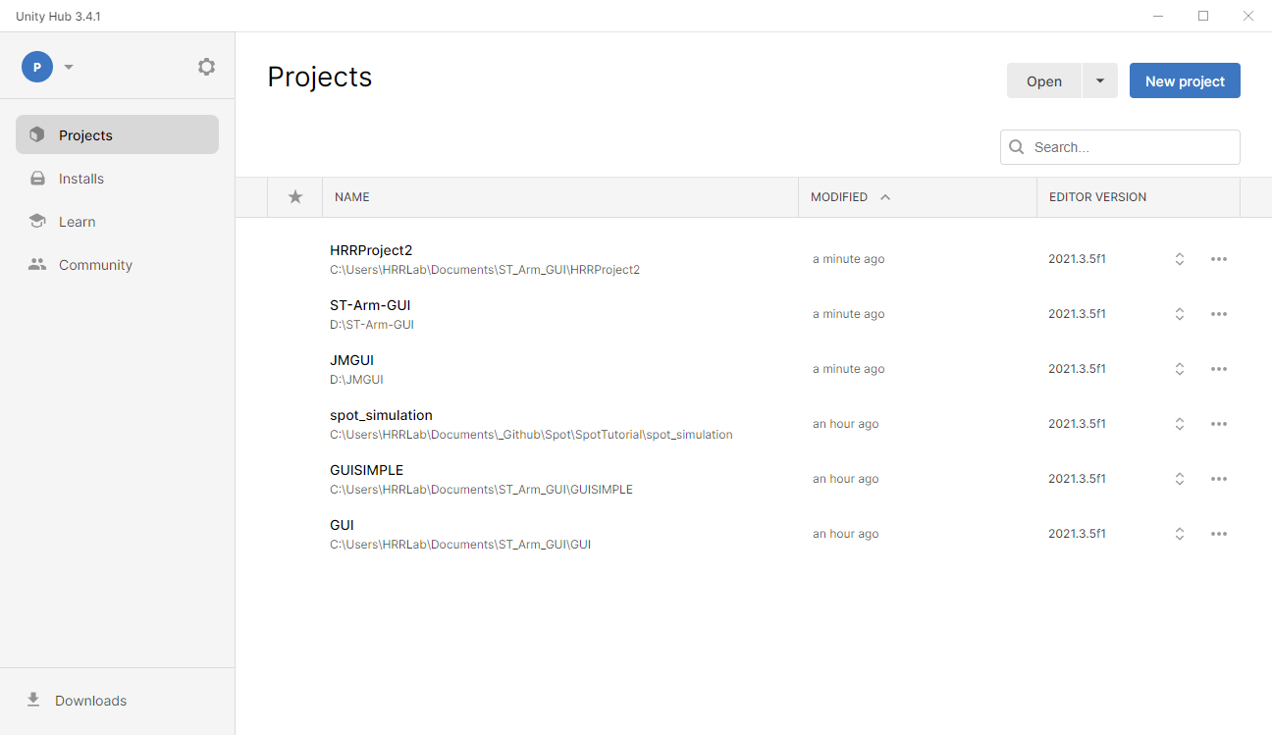
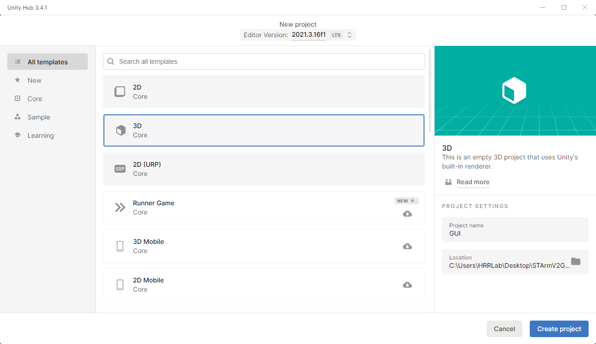
Create new project:
1
2
2
3
4
Press “New project”.
Check “3D Core” and make sure that Editor Version is what you just installed or what you want (LTS “long time support” is preferred).
Name your project and choose a location
Press “Create project” and wait (for one eternity)
Notes:
Press “New project”.
Check “3D Core” and make sure that Editor Version is what you just installed or what you want (LTS “long time support” is preferred).
Name your project and choose a location
Press “Create project” and wait (for one eternity)

Slide 6
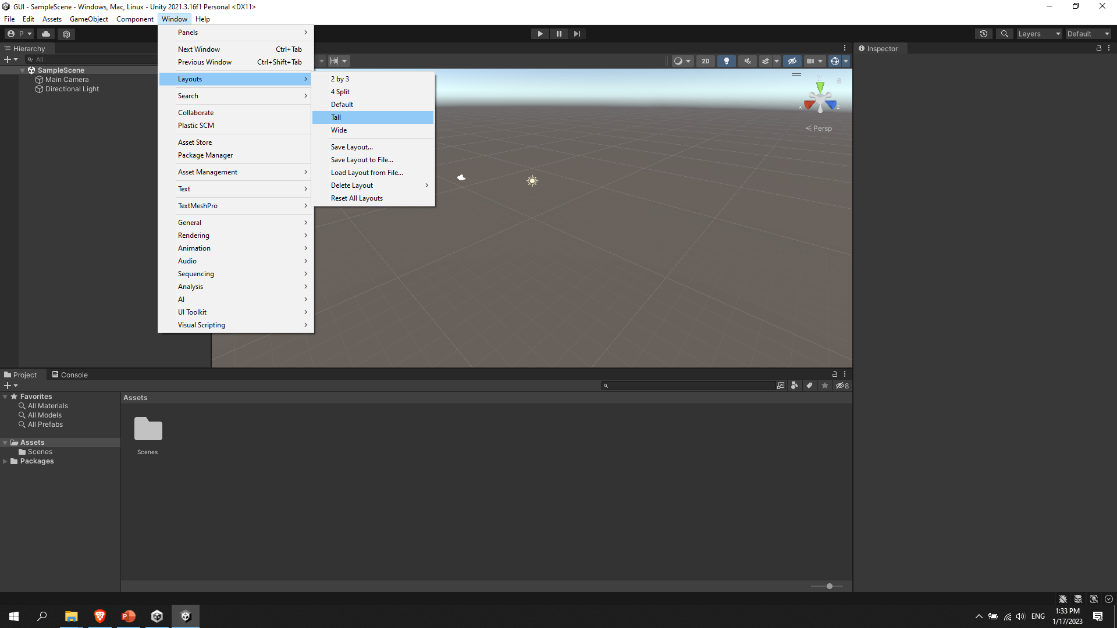
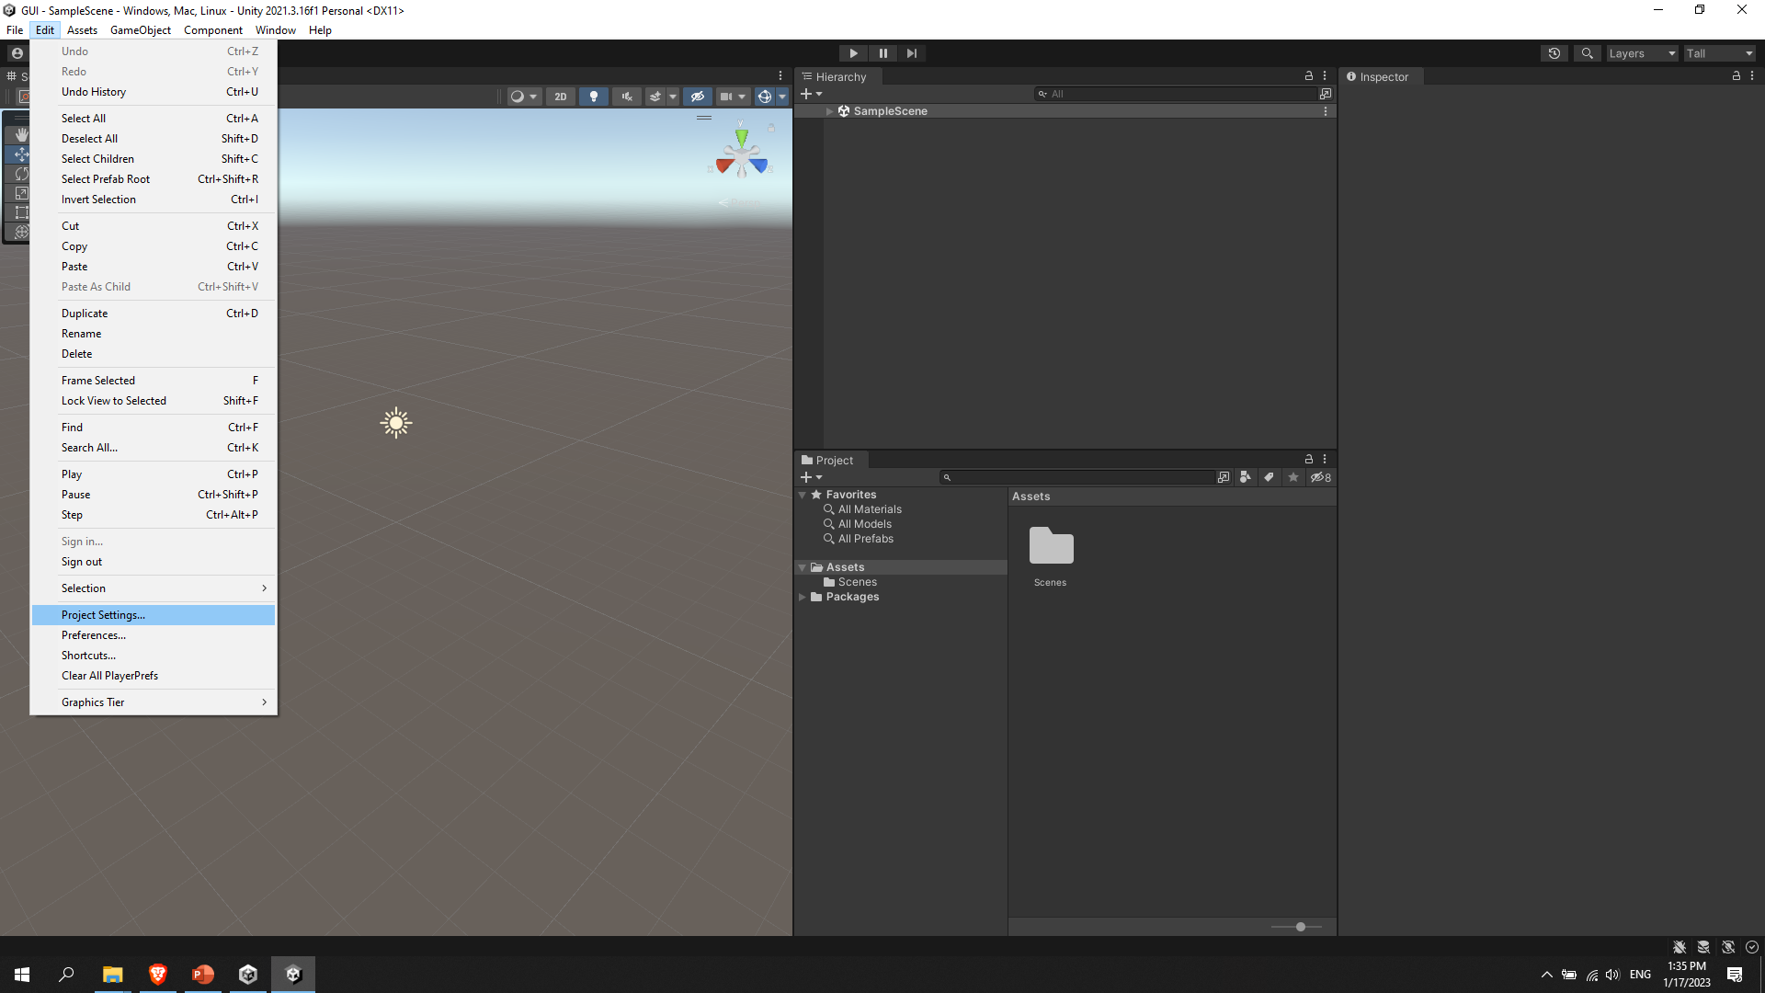
Configure settings:
1
2
Select “Tall” (for conveniency – if you prefer to).
Go to “Project Settings ..”
Notes:
Select “Tall” (for conveniency – if you prefer to).
Go to “Project Settings ..”

Slide 7
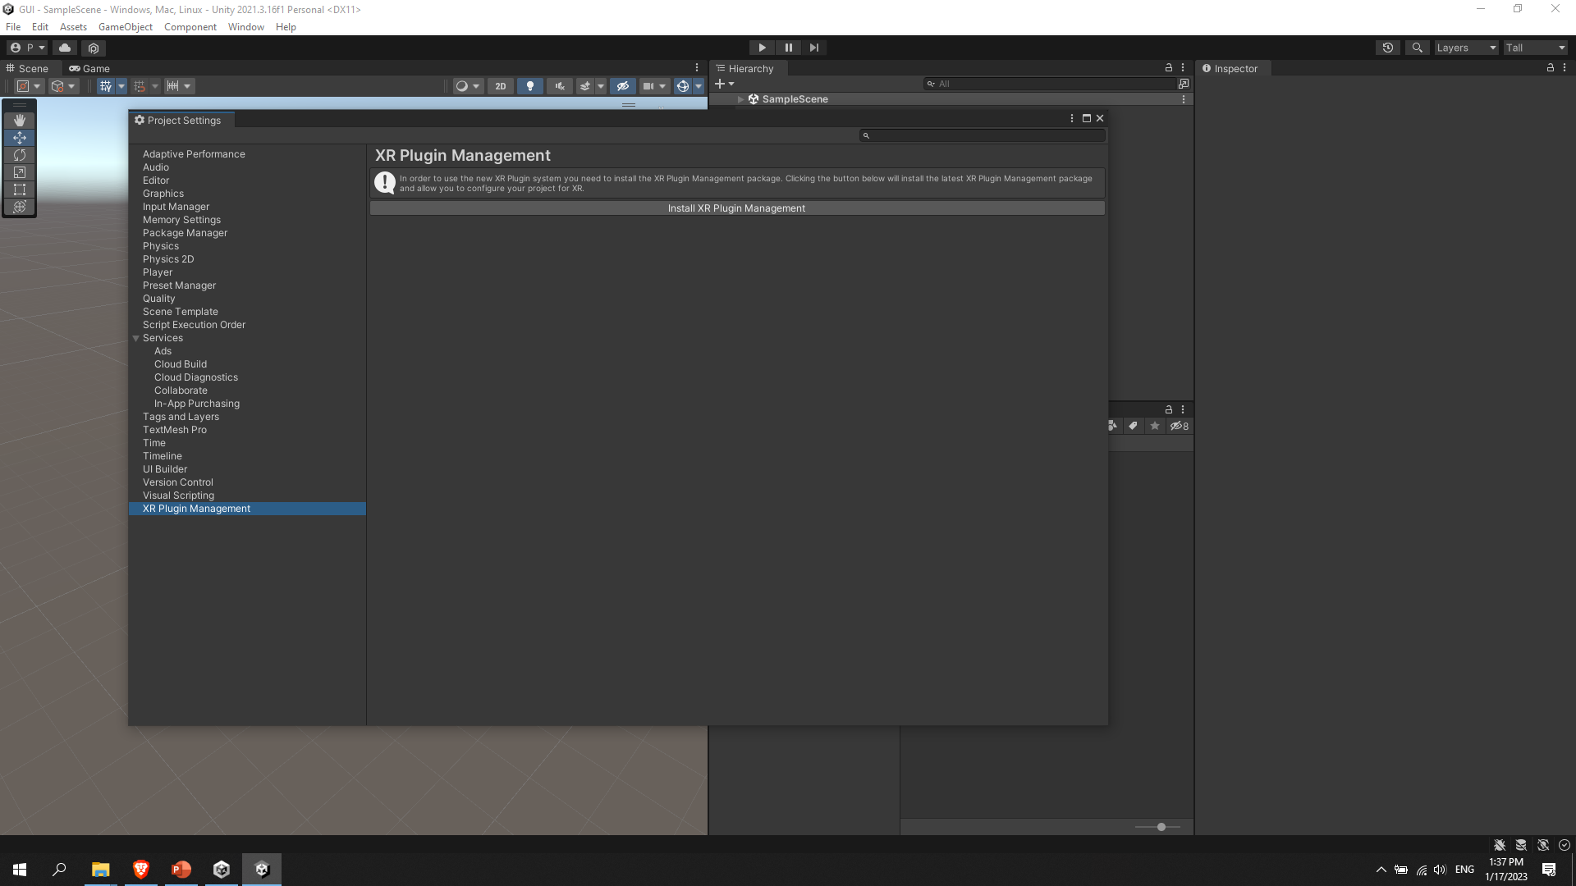
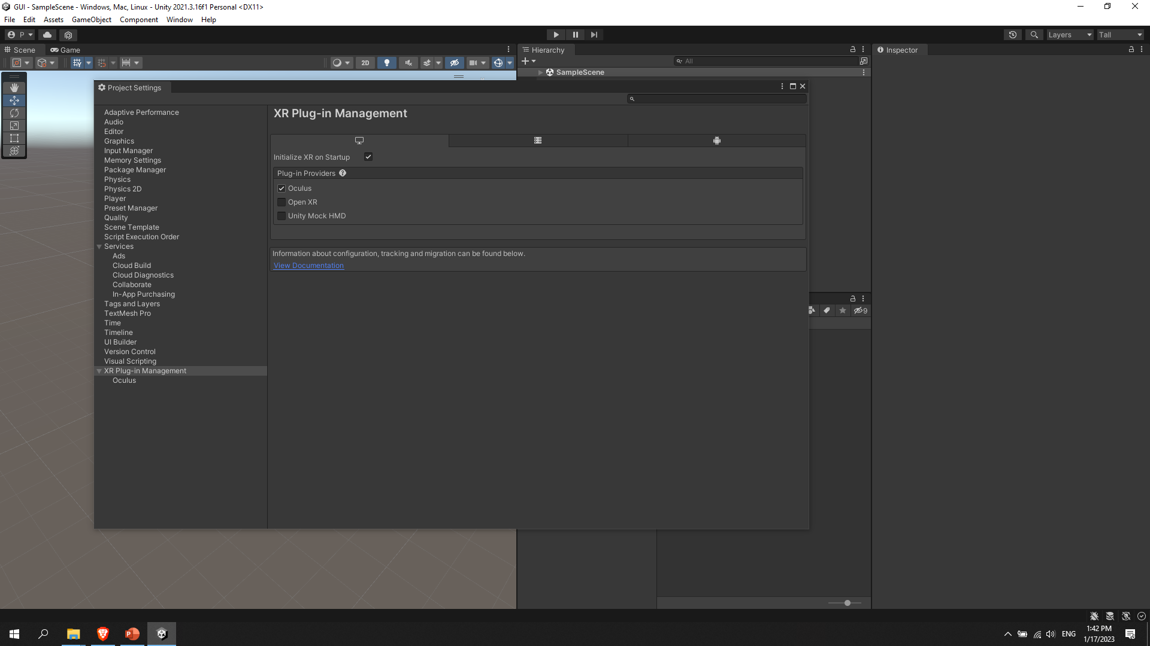
Setup XR Plug-in:
1
2
3
1
Go “XR Plugin Management” window and Press “Install XR Plugin Management” and wait more :) . (This is necessary for using with VR/AR)
In the computer window Check “Oculus” box
Do the same for the Android window
Notes:
Go “XR Plugin Management” window and Press “Install XR Plugin Management” and wait more :) . (This is necessary for using with VR/AR)
In the computer window Check “Oculus” box
Do the same for the Android window

Slide 8
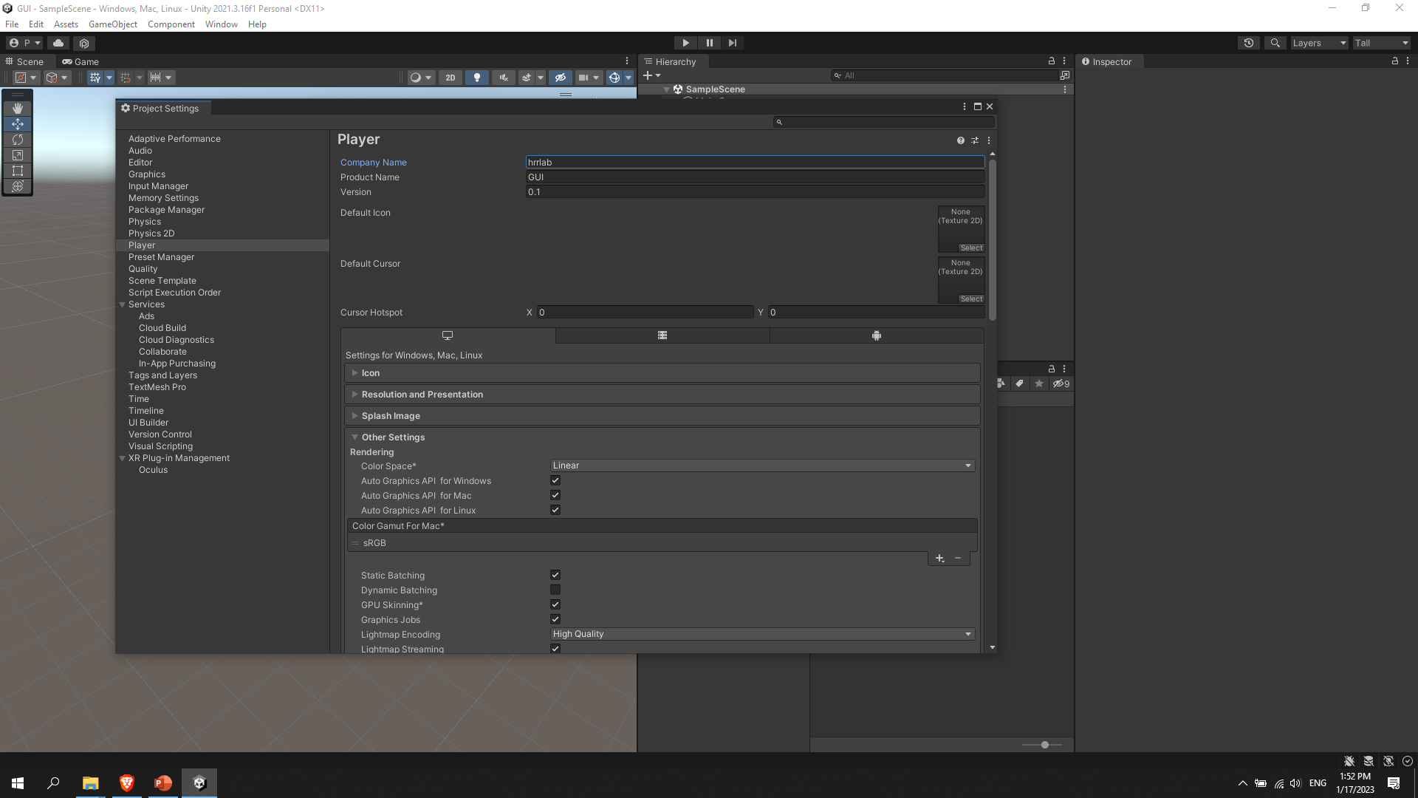
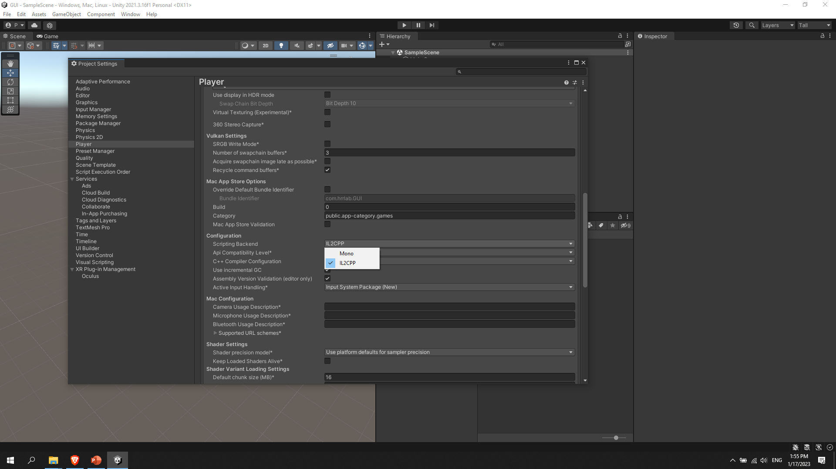
Configure settings:
1
1
2
Go to “Player” window and Configure the top 3 variables :) . (These are good for tracking a version)
Go down and select IL2CPP instead of Mono.
Notes:
Go to “Player” window and Configure the top 3 variables :) . (These are good for tracking a version)
Go down and select IL2CPP instead of Mono.

Slide 9
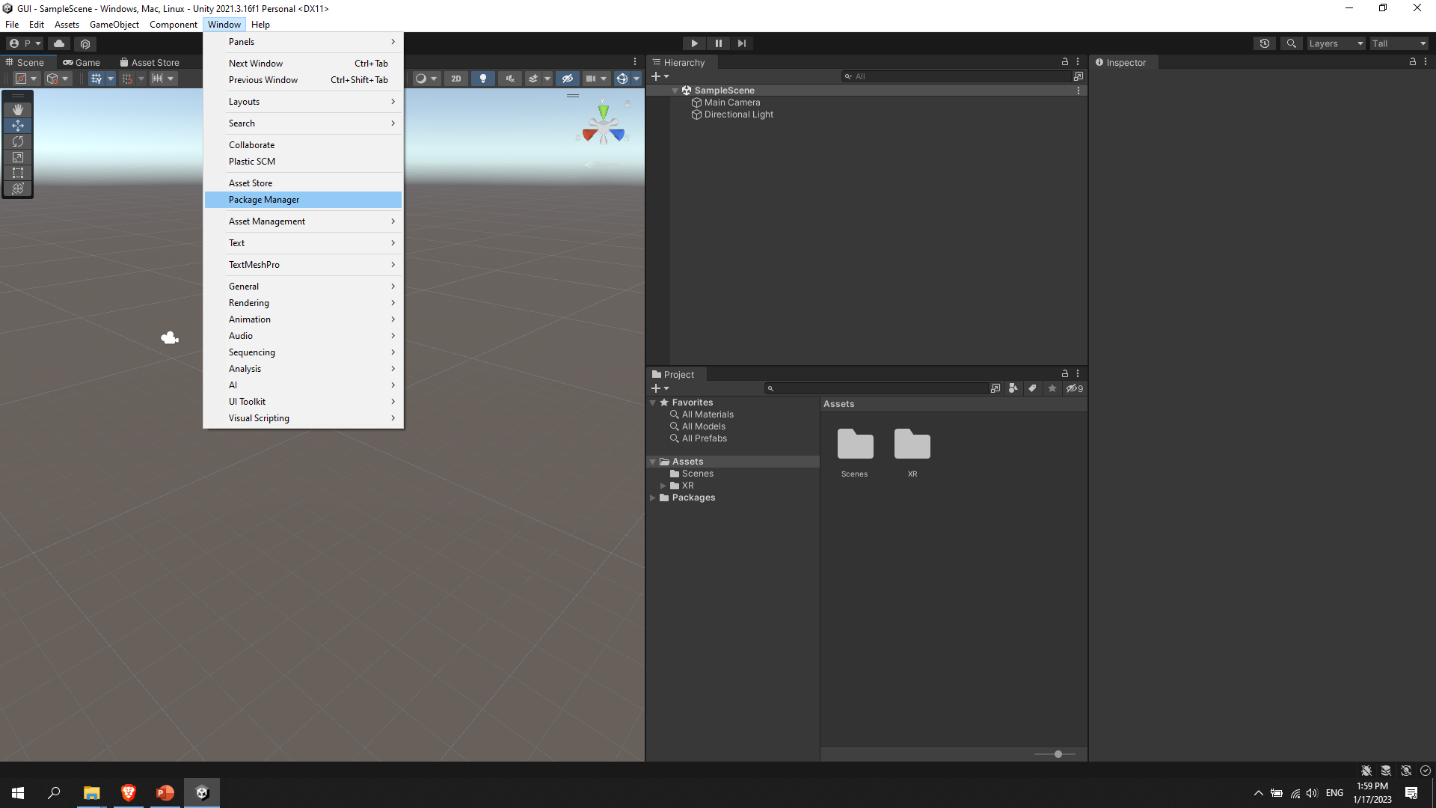
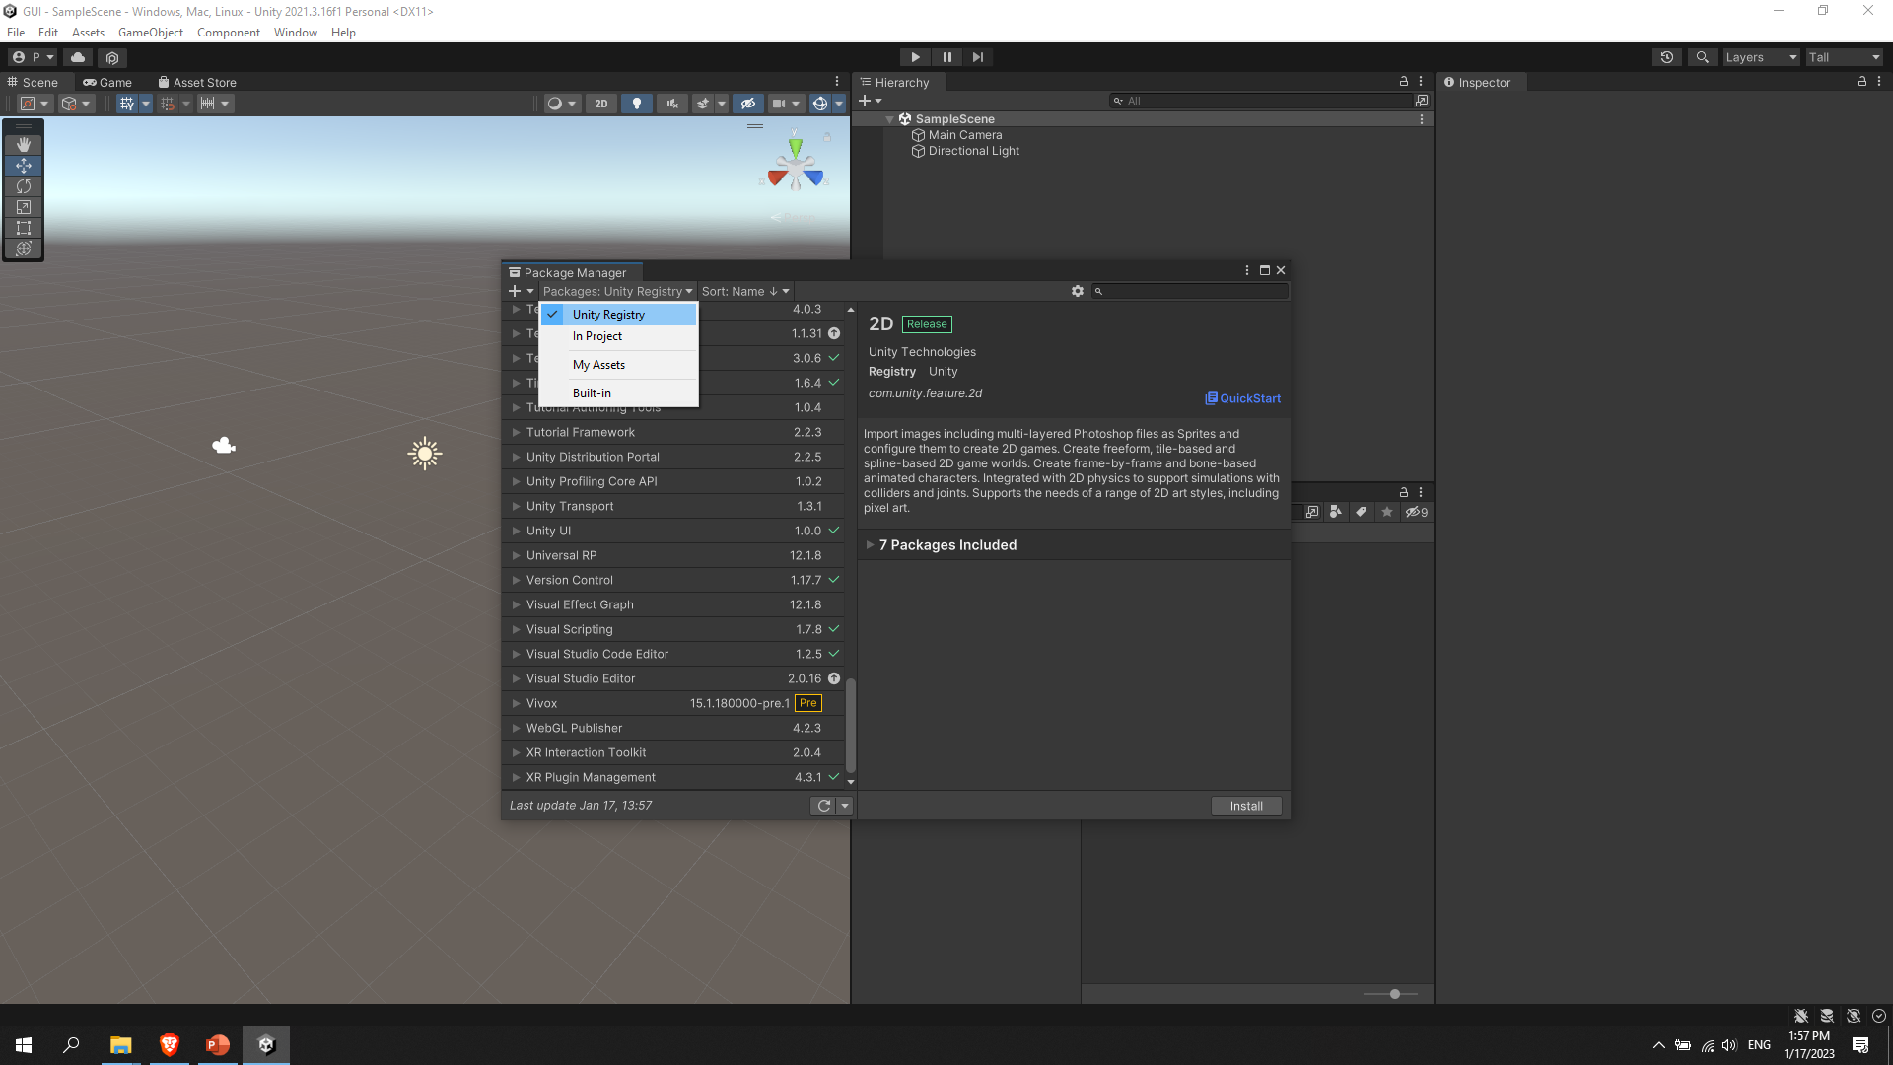
Install necessary packages:
1
2
2
Go to “Package Manager” window (this window is for installing and managing external and internal packages)
Select “Unity Registry” and Press settings button.
Notes:
Go to “Package Manager” window (this window is for installing and managing external and internal packages)
Select “Unity Registry” and Press settings button.

Slide 10
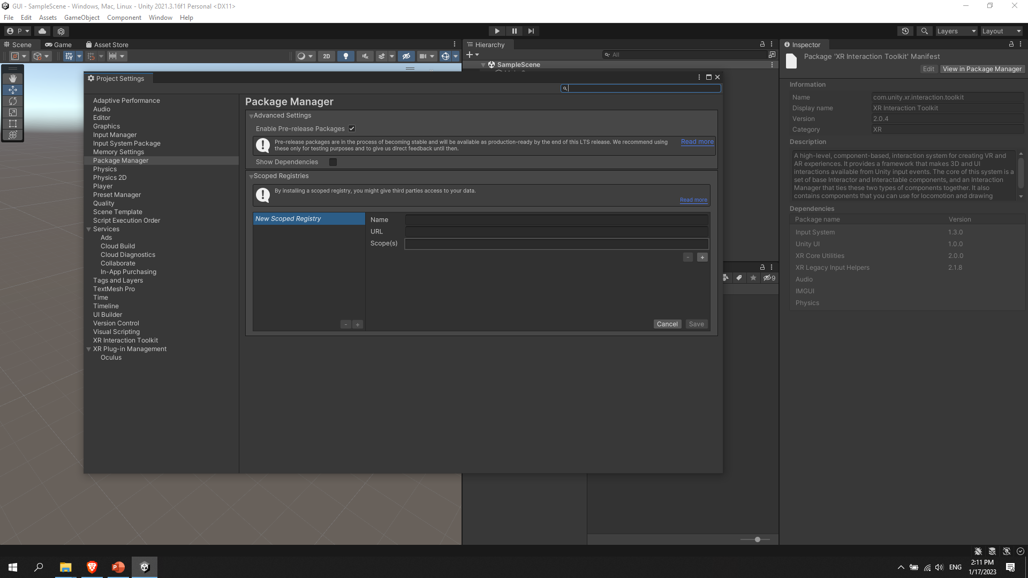
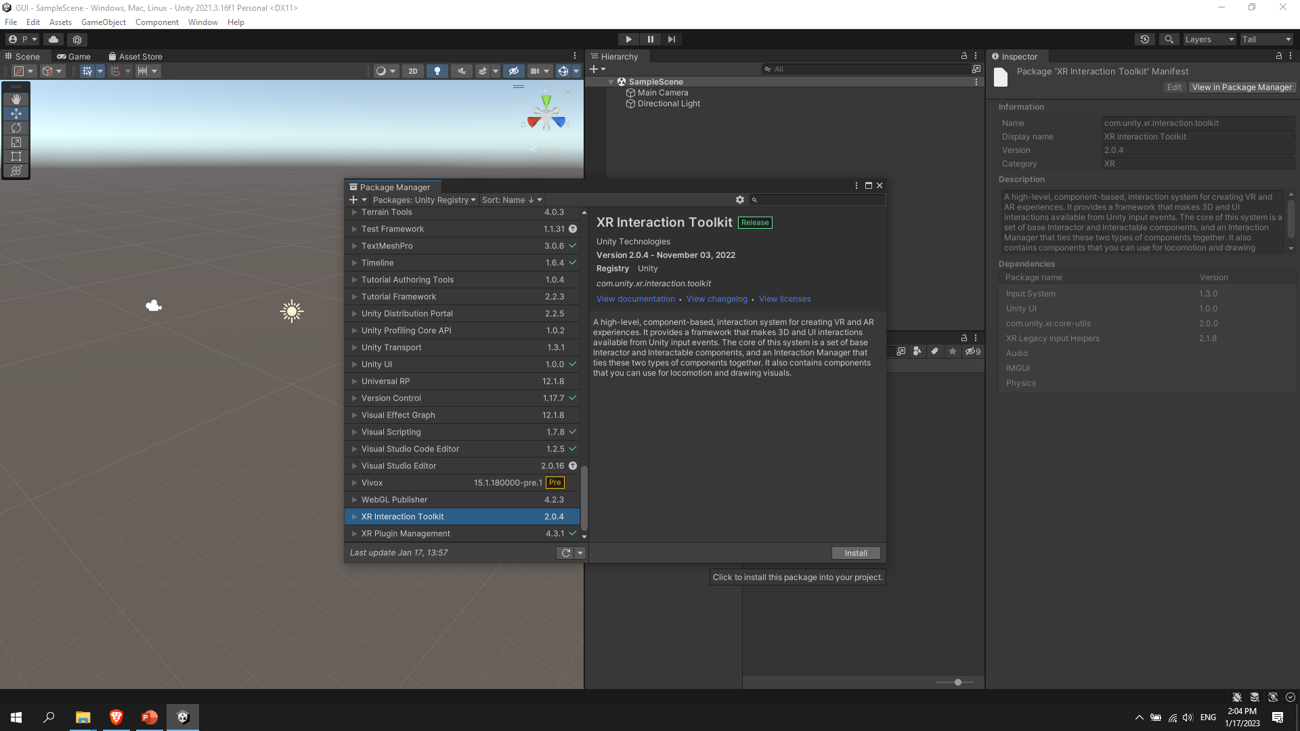
Install necessary packages:
1
2
2
Check “Enable Pre-Release Packages”
Find “XR Interaction Toolkit” and Press “Install” button (This is necessary for project with HMD)
Notes:
Check “Enable Pre-Release Packages”
Find “XR Interaction Toolkit” and Press “Install” button (This is necessary for project with HMD)

Slide 11
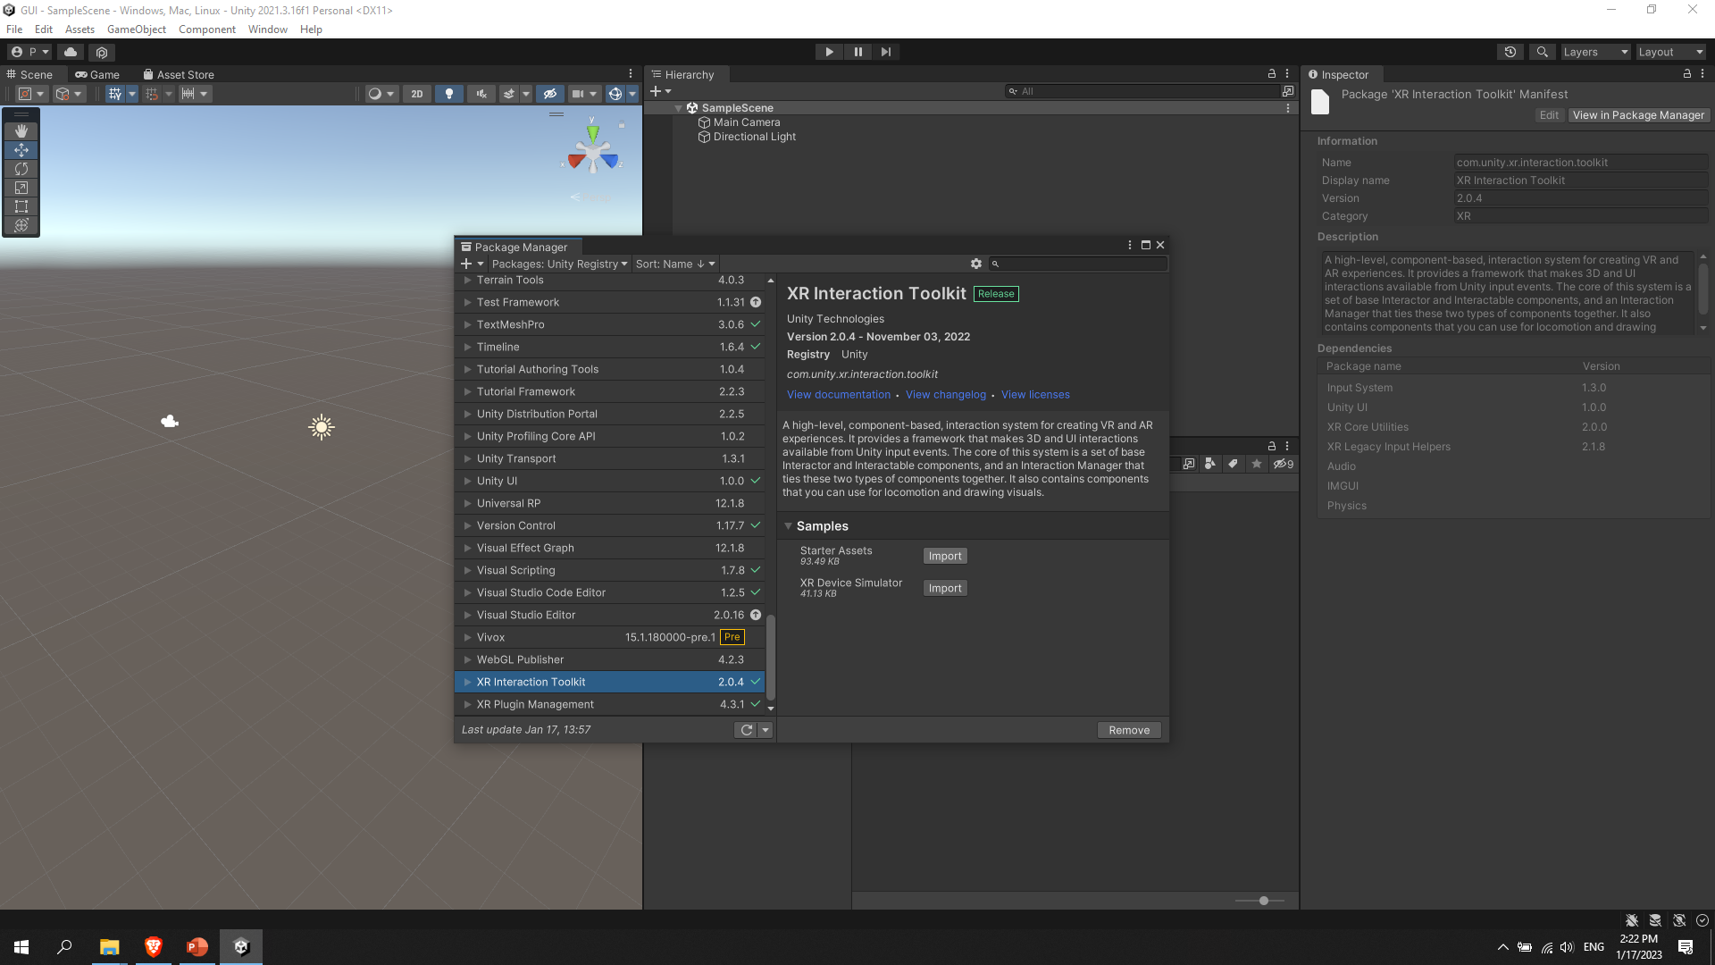
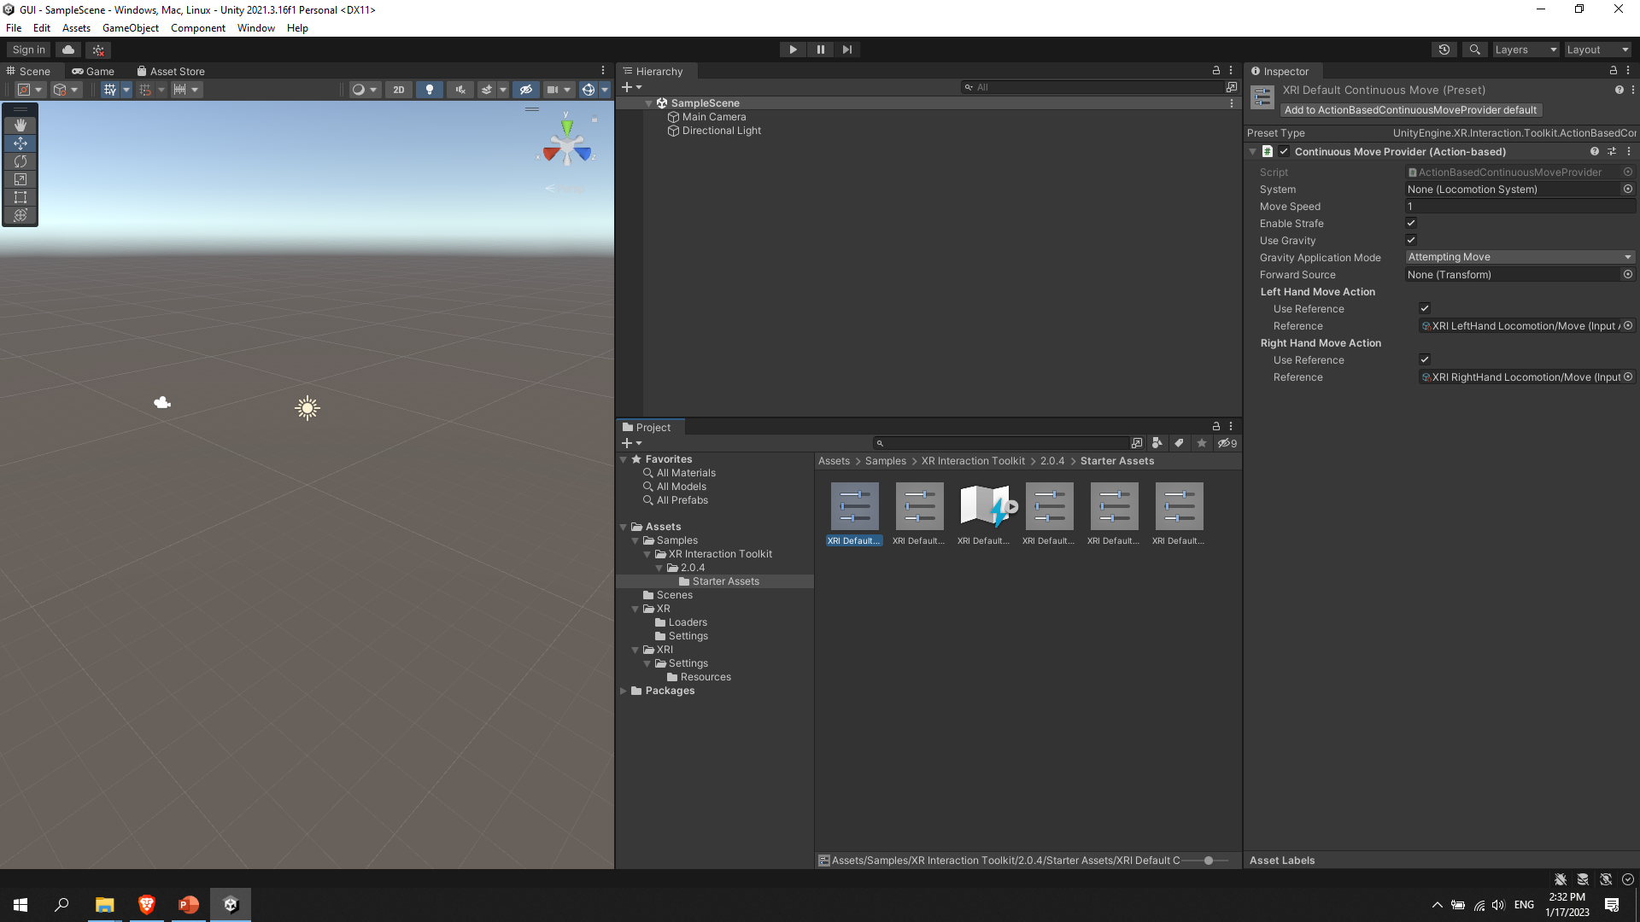
Install necessary packages:
2
4
3
1
Press “Import” of “Starter Assets
Find “Started Assets folder”
Select each of the 5 configuration files
And click “Add ……” button for each configuration files
Notes:
Press “Import” of “Starter Assets
Find “Started Assets folder”
Select each of the 5 configuration files
And click “Add ……” button for each configuration files

Slide 12
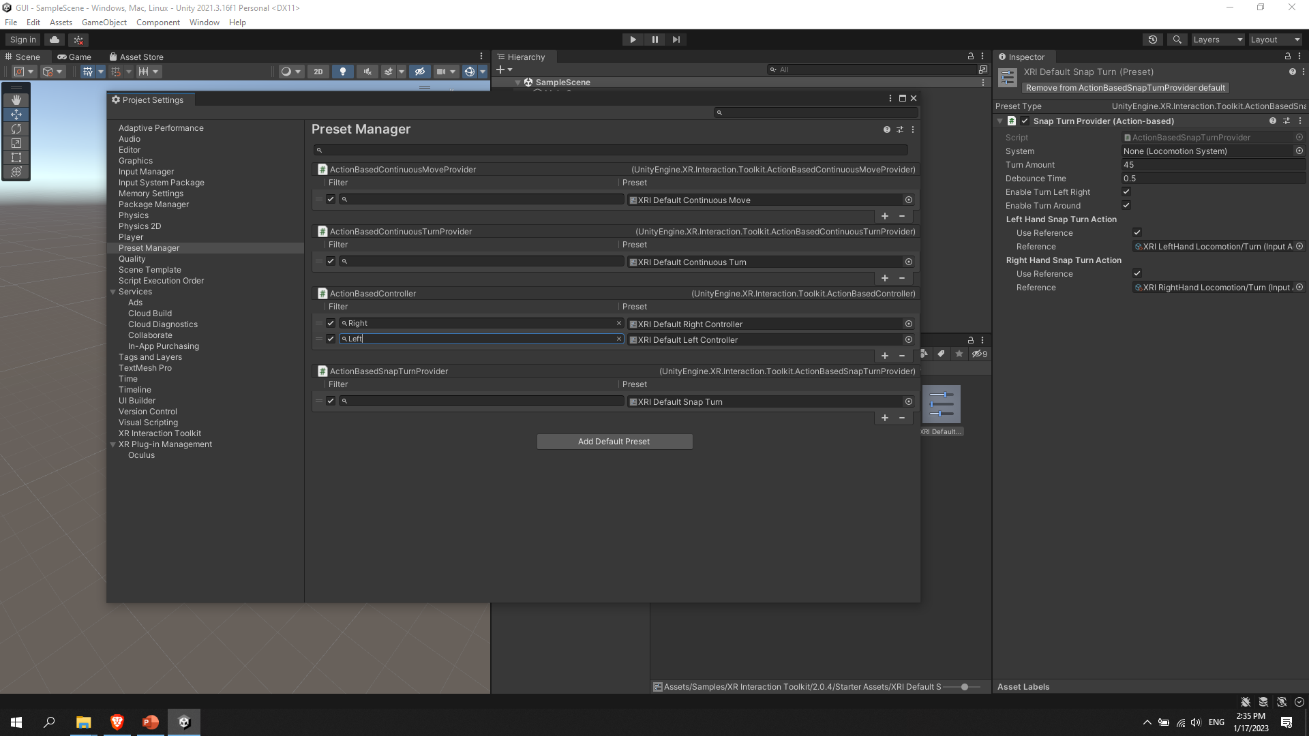
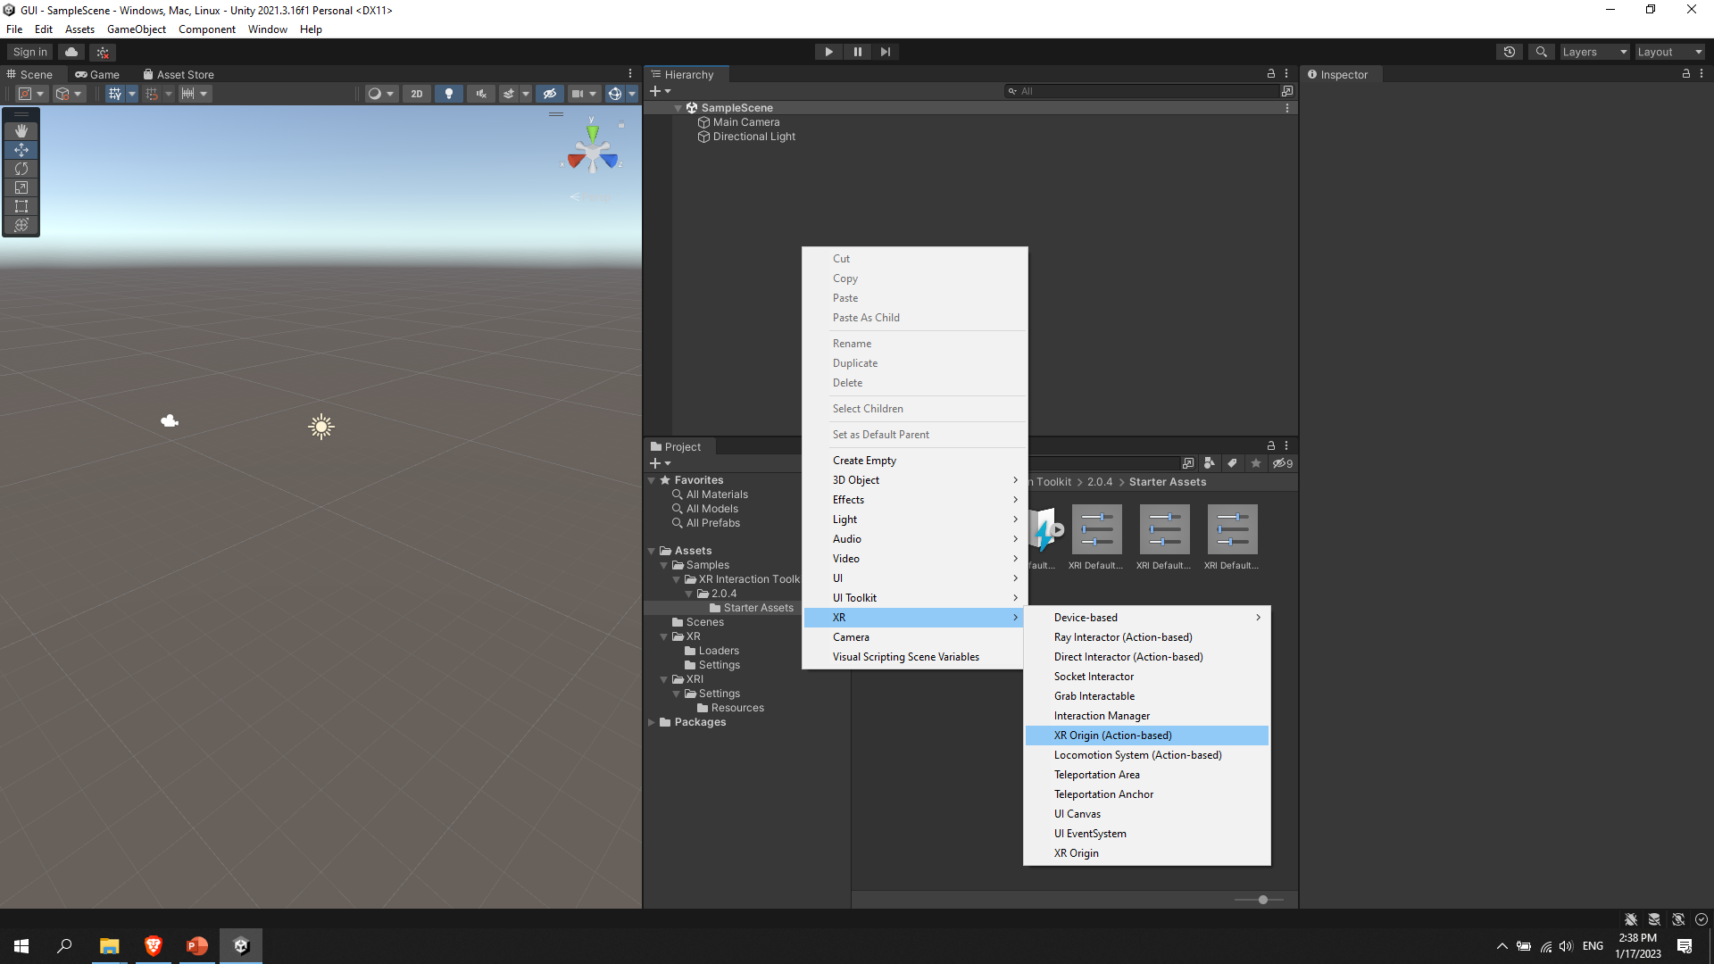
Configure settings:
2
3
1
Go to “Edit” window and “Project Settings” and “Preset Manager”
Fill and type “Right” and “Left” for variables
Go to “Hierarchy -> “Scene” and right click the mouse and go to “XR” -> “XR Origin (Action Based)” and click the repeat the same for adding “Locomotion System (Action Based)”
Notes:
Go to “Edit” window and “Project Settings” and “Preset Manager”
Fill and type “Right” and “Left” for variables
Go to “Hierarchy -> “Scene” and right click the mouse and go to “XR” -> “XR Origin (Action Based)” and click the repeat the same for adding “Locomotion System (Action Based)”

Slide 13
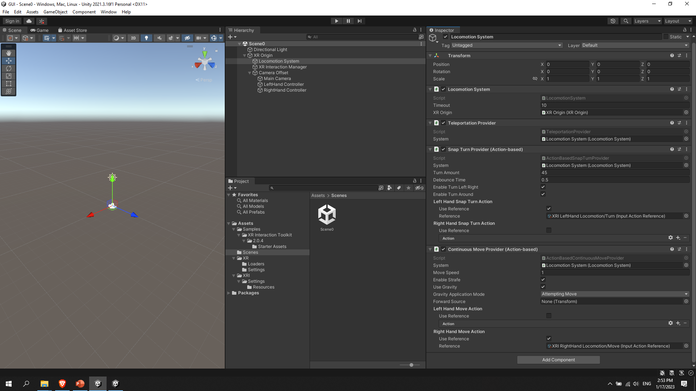
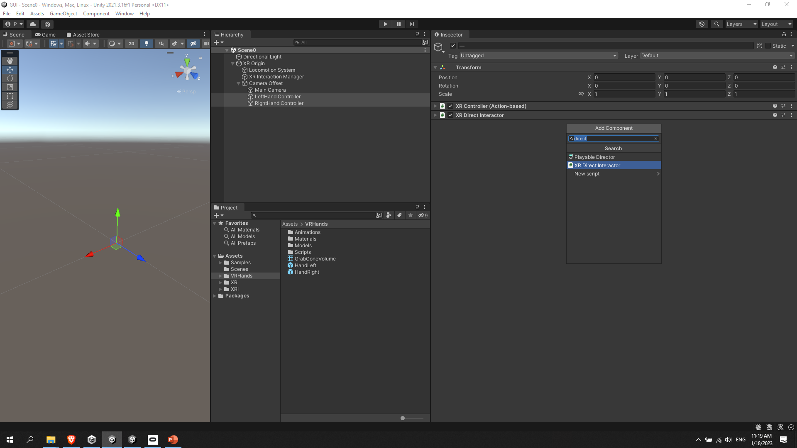
XR Origin:
1
2
3
Reconfigure the Hierarchy in the similar way to this
Configure the Locomotion System similar to this
Select both “Hand Controller” from Hierarchy window and delete every component in them except “Transform” and “XR Controller (Action Based)” and press “Add Component” then search for “XR Direct Interactor”.
Notes:
Reconfigure the Hierarchy in the similar way to this
Configure the Locomotion System similar to this
Select both “Hand Controller” from Hierarchy window and delete every component in them except “Transform” and “XR Controller (Action Based)” and press “Add Component” then search for “XR Direct Interactor”.

Slide 14
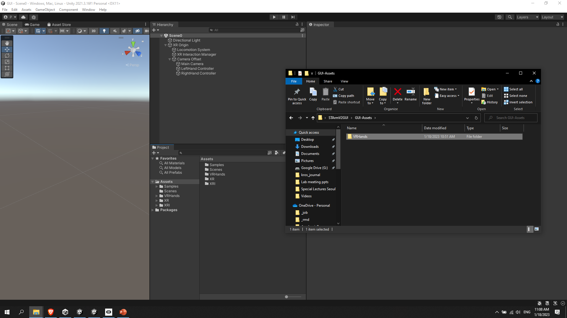

Animated virtual hands:
1
2
Drag and Drop (VRHands folder is provided and it’s necessary for animating transparent virtual hands)
Drag and Drop (Inside VRHands folder there is “HandRight” and “HandLeft” prefabs they need to be placed accordingly to “ __Hand Controller”)

Slide 15
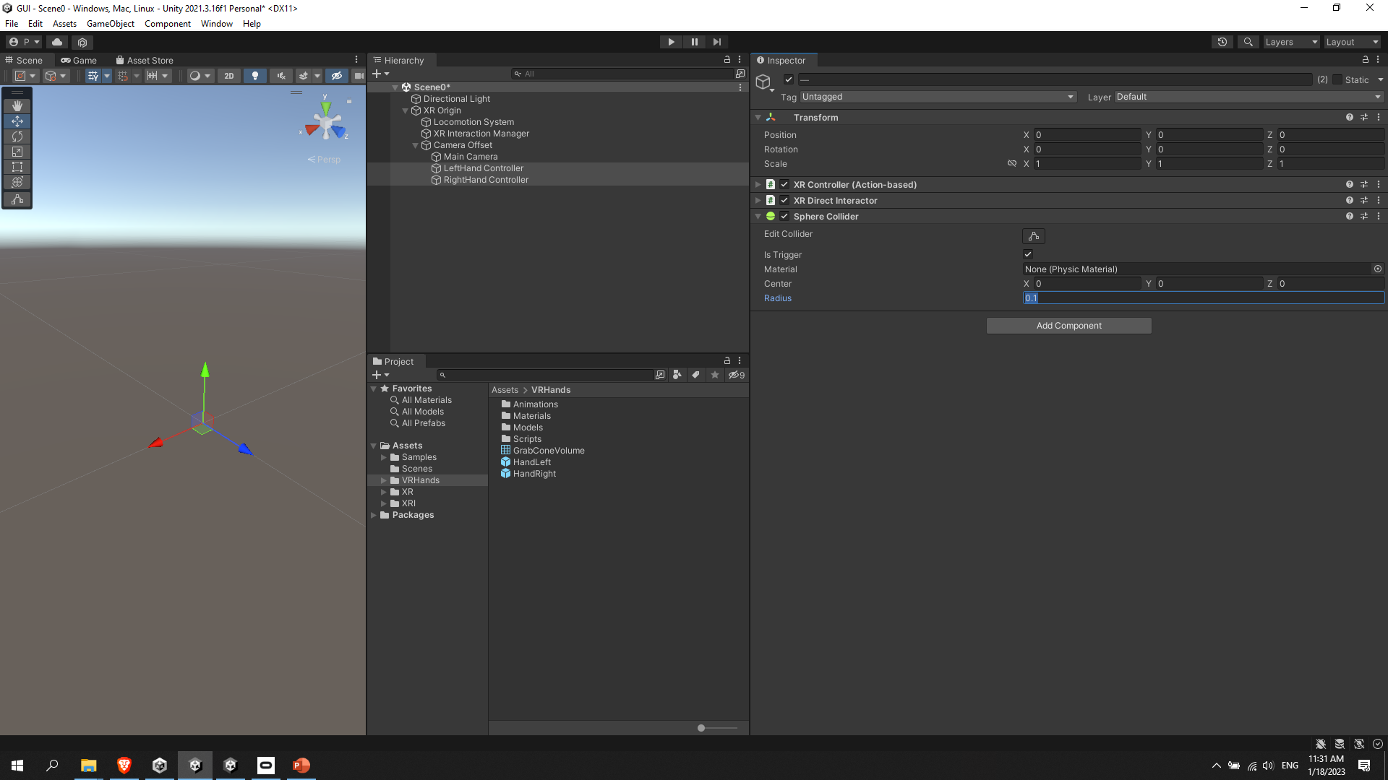
Collider (trigger):
2
Check if everything work as expected. (Light saber should disappear and transparent hands should appear for each hand with animations)
Select both “Hand Controller” from Hierarchy window → Press “Add Component” → “Sphere Collider” → Check “Is Trigger” box → Change “Radius” to 0.1 (you can change it as you wish)

Slide 16
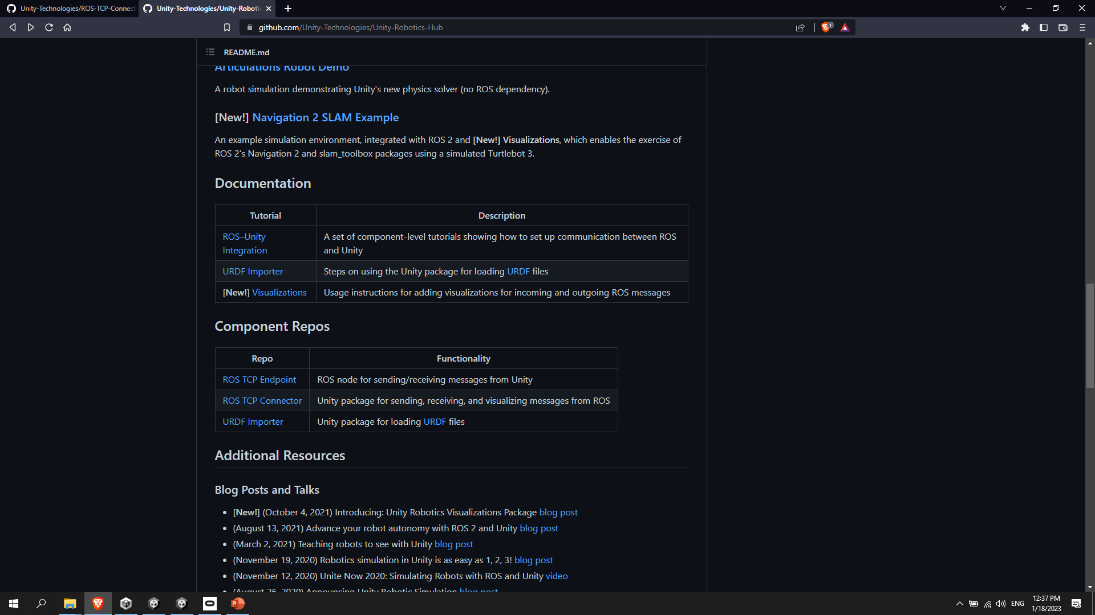
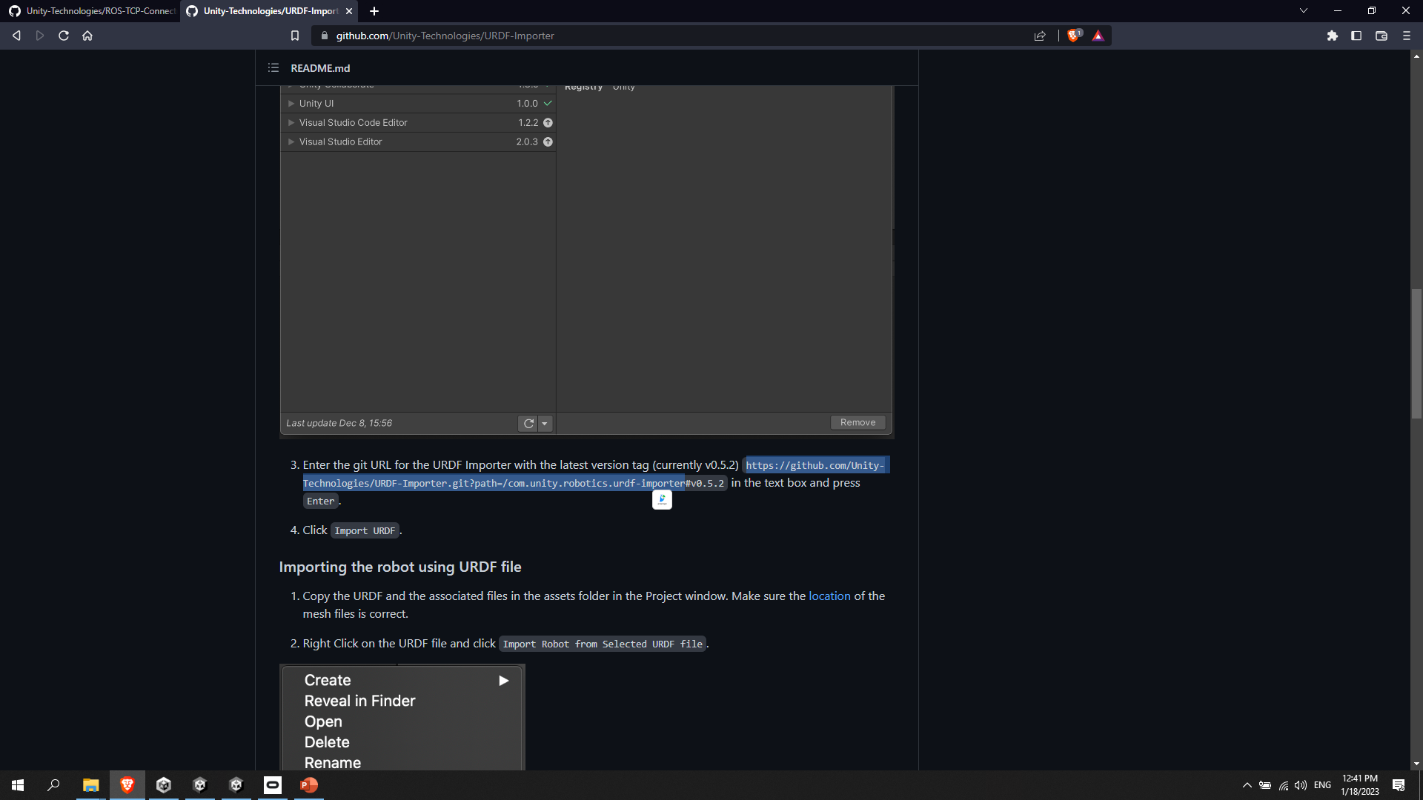
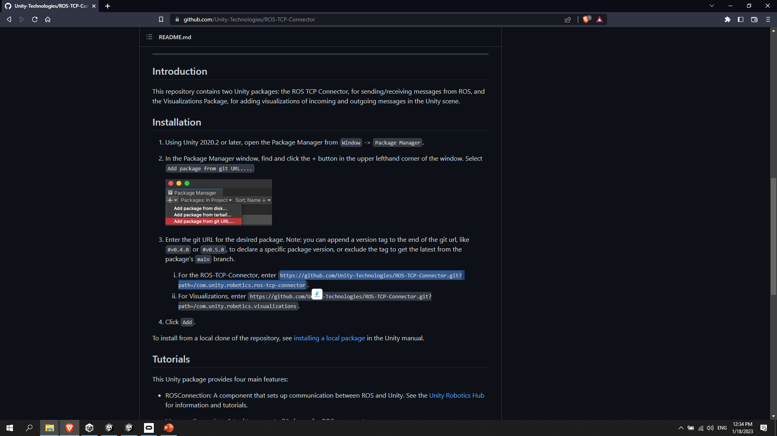
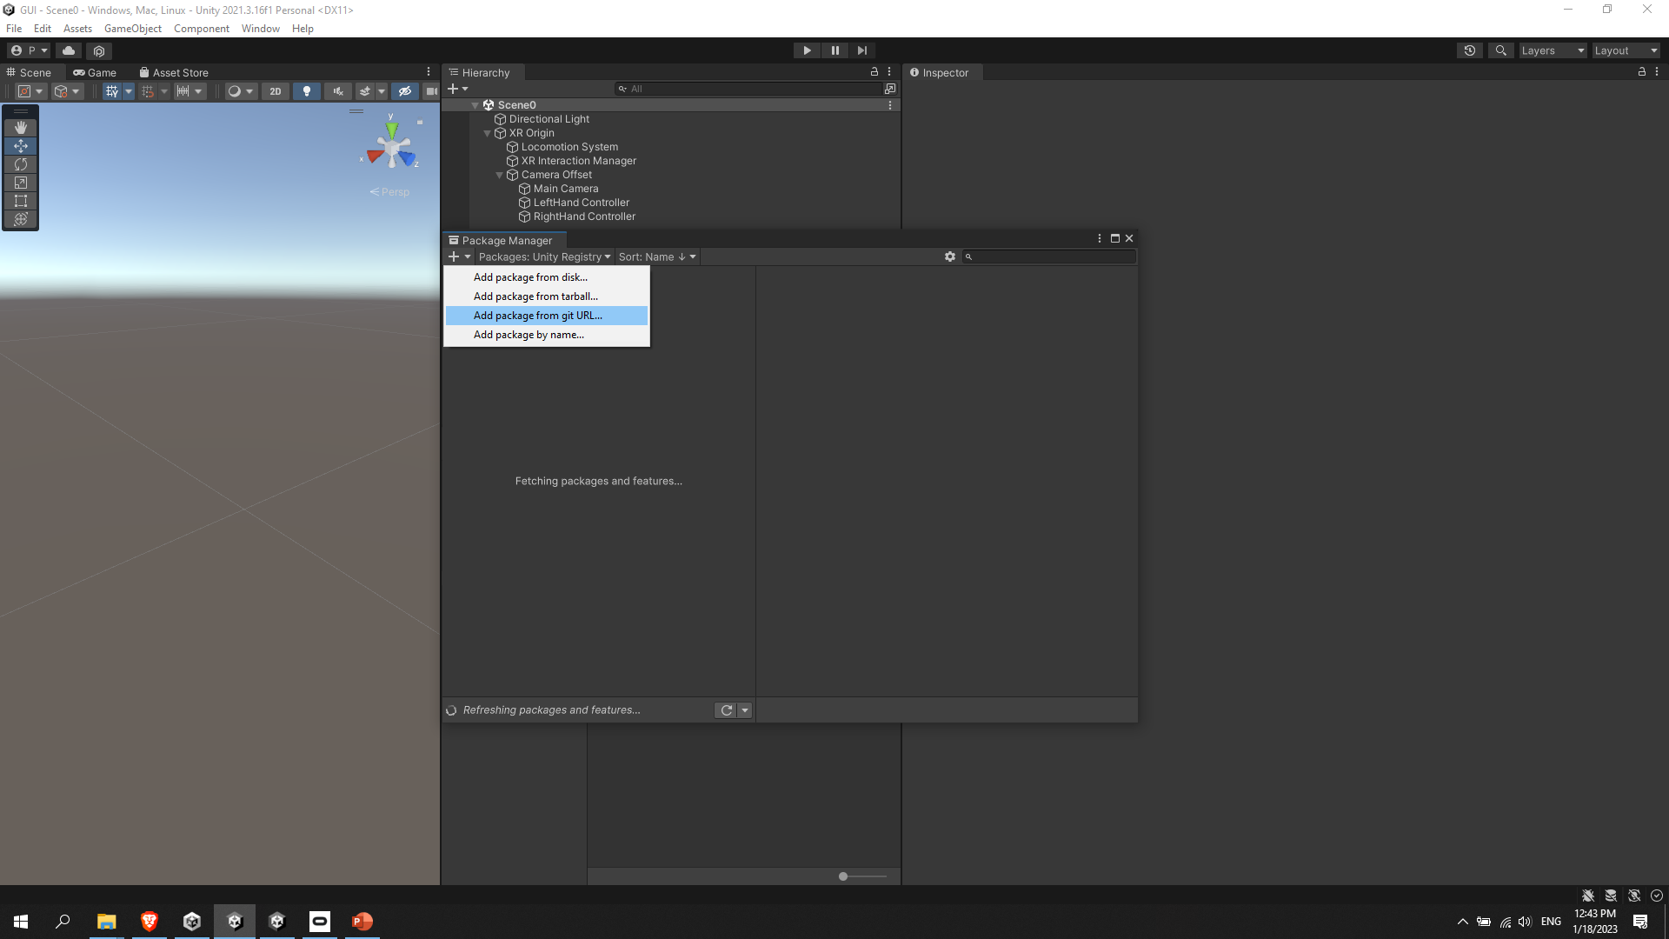
1
Setup Unity:
1.2
1
2
1.1
Notes:
https://github.com/Unity-Technologies/Unity-Robotics-Hub
https://github.com/Unity-Technologies/ROS-TCP-Connector
https://github.com/Unity-Technologies/ROS-TCP-Connector.git?path=/com.unity.robotics.ros-tcp-connector
https://github.com/Unity-Technologies/ROS-TCP-Connector.git?path=/com.unity.robotics.visualizations
https://github.com/Unity-Technologies/URDF-Importer
https://github.com/Unity-Technologies/URDF-Importer.git?path=/com.unity.robotics.urdf-importer
2. Go to “Package Manager” → Click “+” → Click “Add Package from git URL ..” → Enter URL from 1.1.1, 1.1.2, 1.2.1, sequentially and add packages.

Slide 17
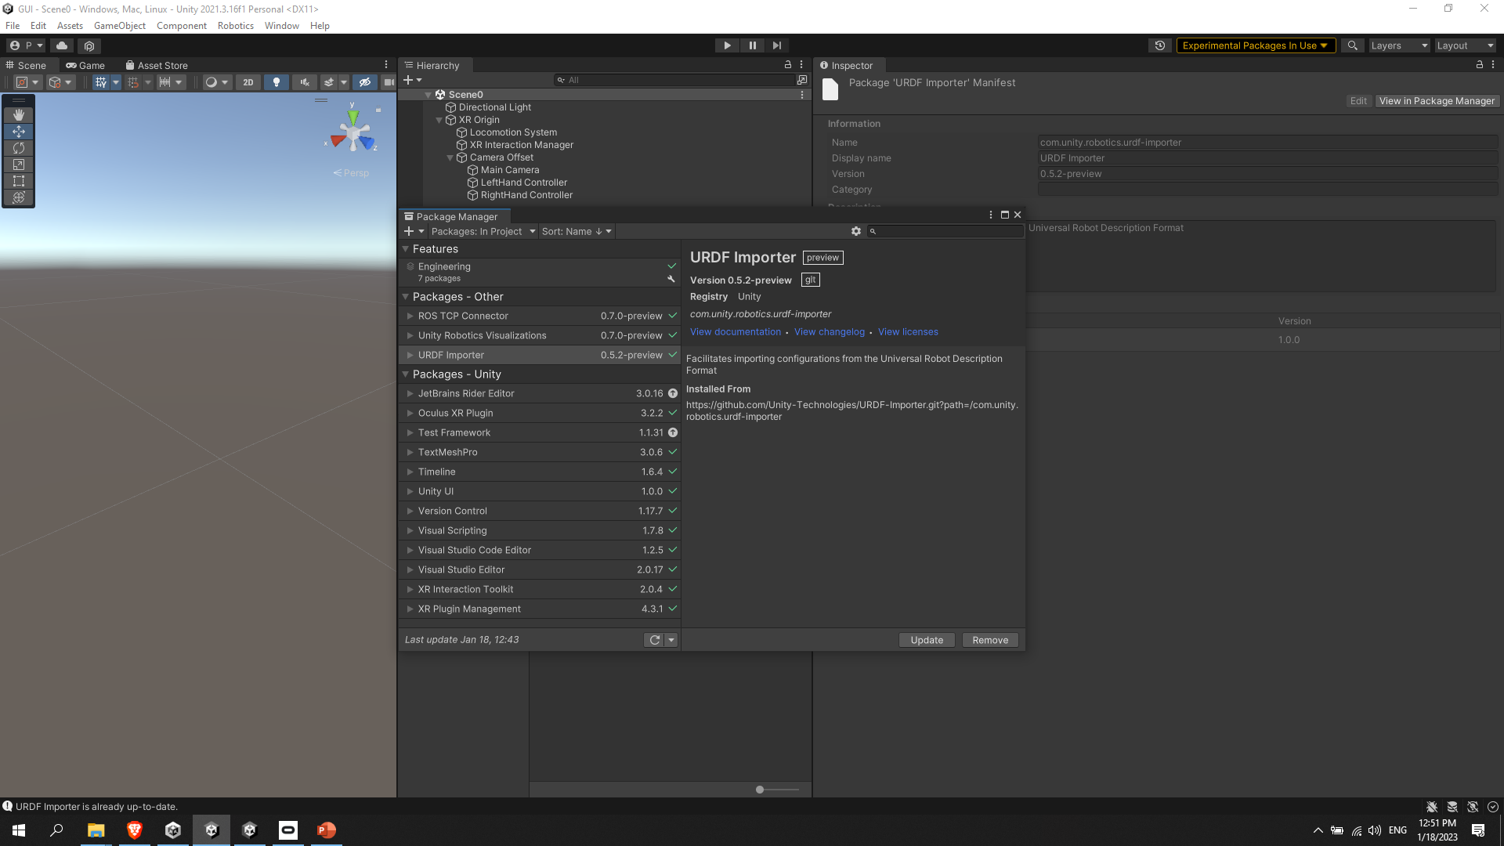
Install Robotics packages:
2
1
Check if this list is similar to yours
Select both “Hand Controller” from Hierarchy window → Press “Add Component” → “Sphere Collider” → Check “Is Trigger” box → Change “Radius” to 0.1 (you can change it as you wish)

Slide 18
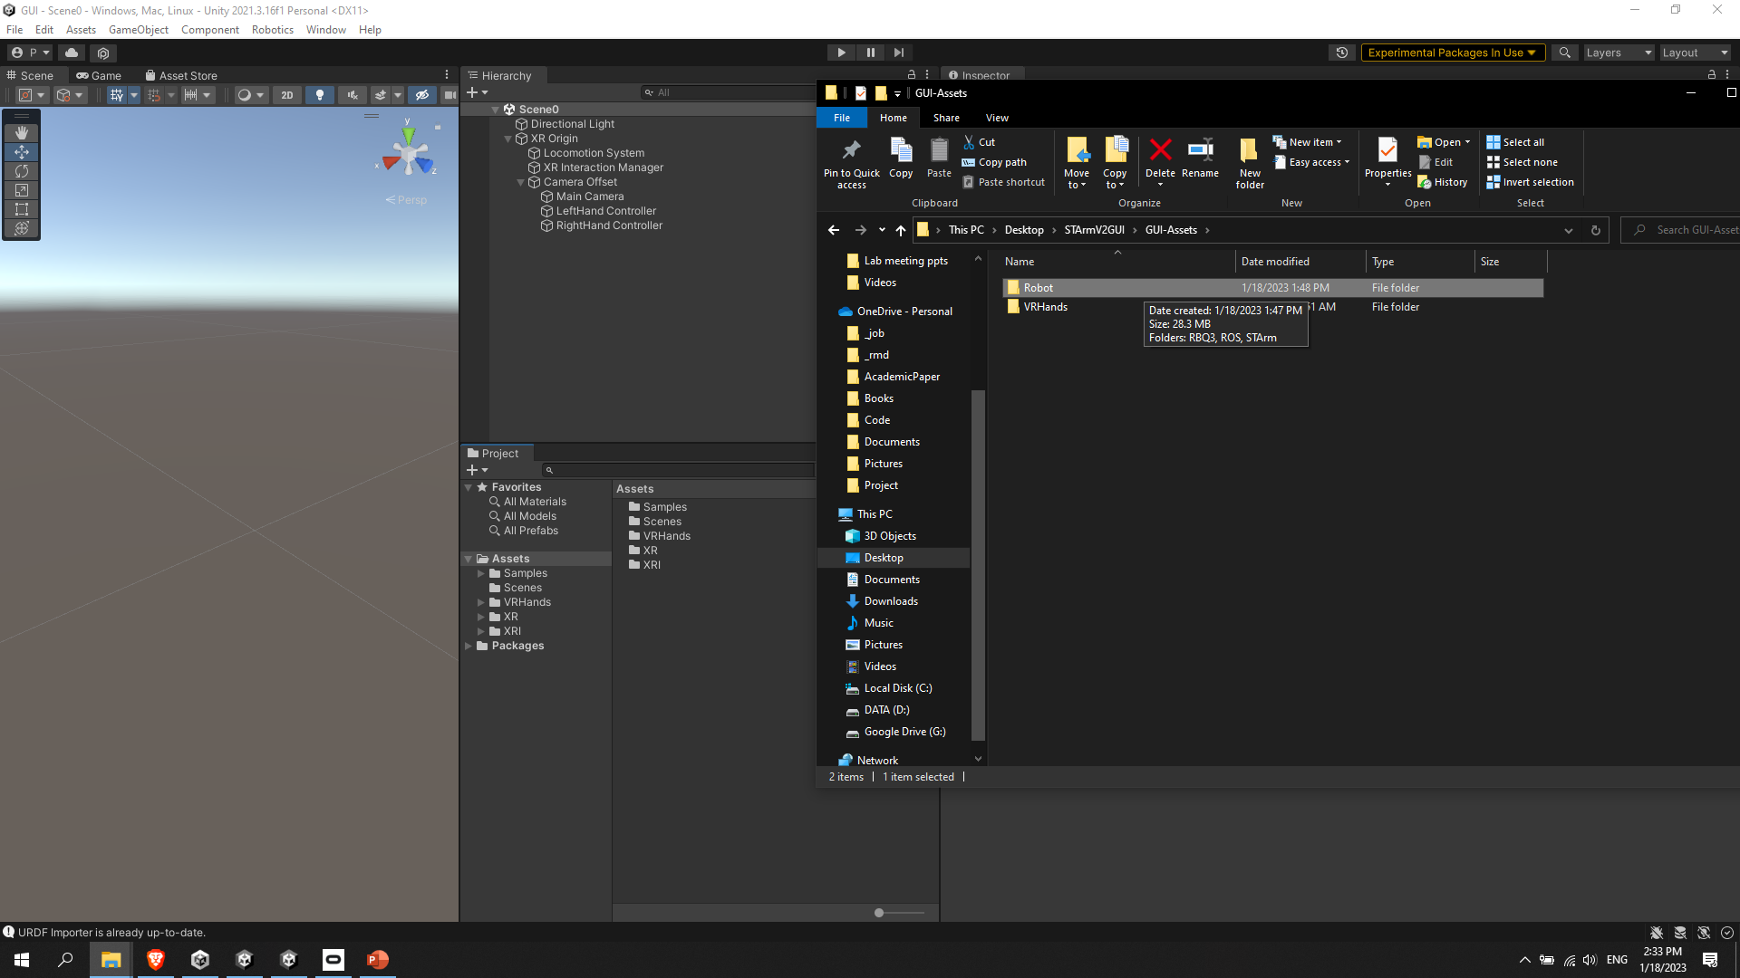
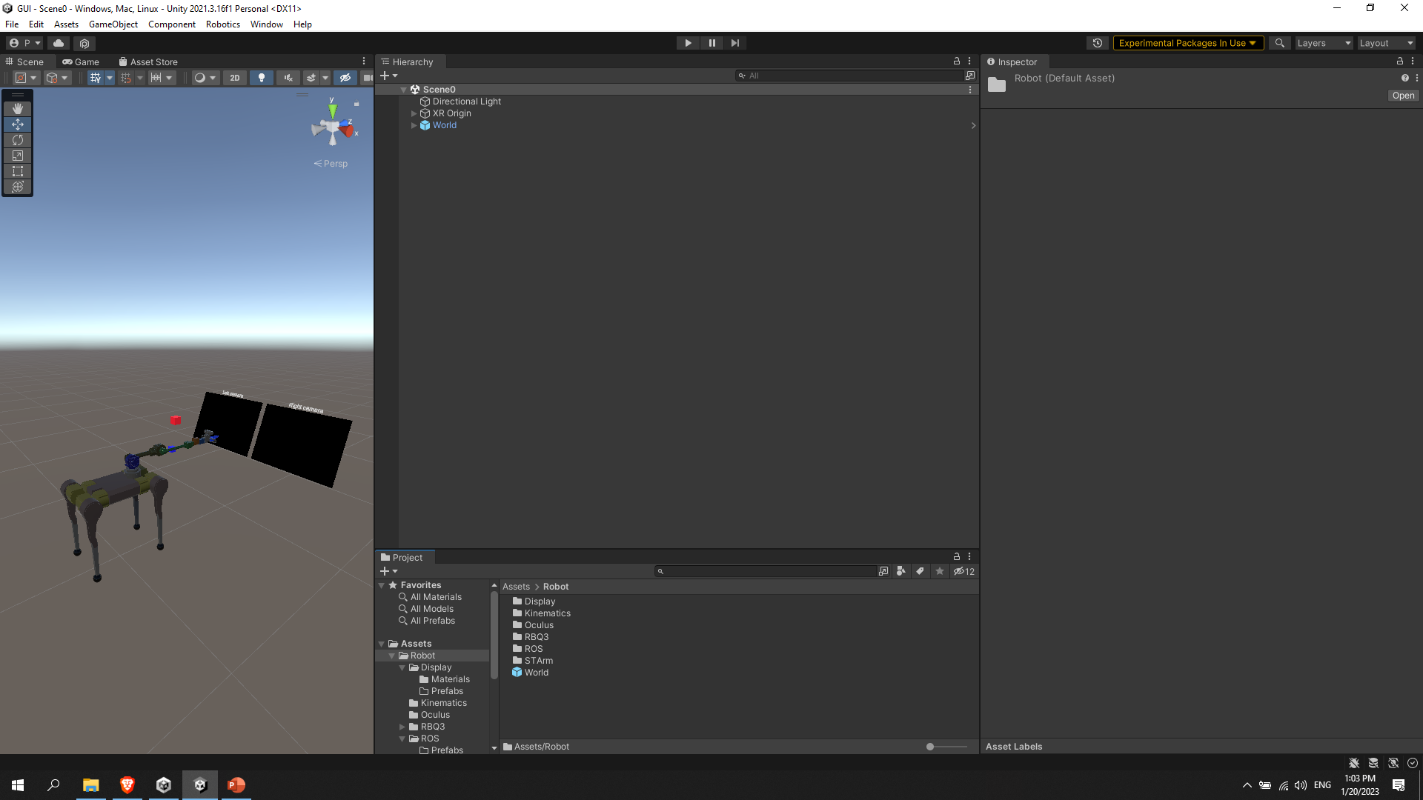
Spawn robot:
2
1
Drag and Drop (Robot folder is provided and it’s necessary for creating robot)
Drag and Drop (World prefab to the Scene)

Slide 19
Thank You!

